Slide 1
Introduction to R
Marc Cañigueral
eXiT – UdG
July 2020

Slide 2
R environment
Download R 3.6.3: https://cran.r-project.org/bin/windows/base/old/3.6.3/
Download Rstudio: https://rstudio.com/products/rstudio/download/
Documentation:
Learning: {bookdown} (R for Data Science, Forecasting, Building Shiny Apps, etc)
Packages: cheatsheets , {pkgdown} (renv, reticulate, devtools, mclust, etc)
Recommended packages:
Dependencies manager: {renv}
R for data science: {tidyverse} (https://www.tidyverse.org/)
R for time series: {tidyverts} (https://tidyverts.org/)
Reporting: {rmarkdown}, {knitr}, {rticles}
Web applications: {shiny} and {golem}
Package development: {devtools}

Slide 3
RStudio
Scripts
Console
Environment/Git
Files
.Rproj: project metadata
.Rprof: “on load” functions
.Renviron: “on load” variables
.Rhist: historic of commands
.RData: environment data

Slide 4
R base - Python
Assignations with “<-”, “->” or “=“
Functional programming vs Object oriented programming.
Use package {R6} for OOP classes in R
In functions use “superassignment” to set global variables: “<<-”
Packages functions:
python: import numpy as np R: library(dplyr)
python: np.matrix() R: dplyr::filter()
Installing a package in R: install.packages(“dplyr”)
Objects types python: type(x) R: class(x)

Slide 5
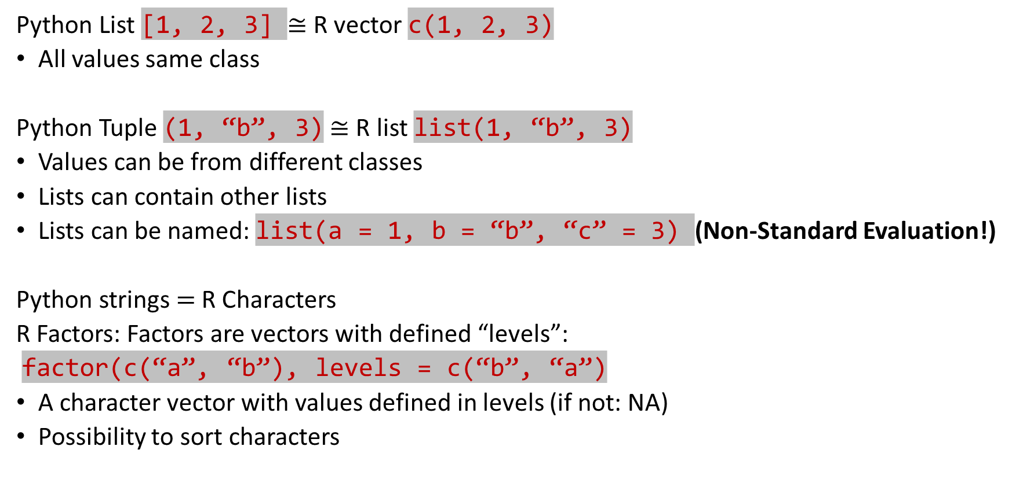
R base – Python: data classes
Python List [1, 2, 3] $≅$ R vector c(1, 2, 3)
All values same class
Python Tuple (1, “b”, 3)$≅$ R list list(1, “b”, 3)
Values can be from different classes
Lists can contain other lists
Lists can be named: list(a = 1, b = “b”, “c” = 3) (Non-Standard Evaluation!)
Python strings $=$R Characters
R Factors: Factors are vectors with defined “levels”:
factor(c(“a”, “b”), levels = c(“b”, “a”)
A character vector with values defined in levels (if not: NA)
Possibility to sort characters

Slide 6
R base: data classes
Data frames
python: pd.DataFrame() R: data.frame()
Matrix
python: np.matrix() R: matrix()
Conversions: as.vector(), as.list(), as.data.frame(), as.factor(), as.character(), as.numeric(), as.integer()
Checks: is.vector(), is.list(), is.data.frame(), is.factor(), is.character(), is.numeric(), is.integer(), is.null(), is.na()
In python combinations start at index 0, in R at index 1

Slide 7
Tidyverse: Data science tools
Main concepts of this philosofy:
Non-Standard Evaluation (NSE): names in data.frames and lists defined without quotation marks
l <- list(a = 1, b = “b”, c = 3)
df <- data.frame(a = c(1, 2, 3), b = c(4, 5, 6))
Tibble (https://tibble.tidyverse.org/articles/tibble.html)
A tibble is a data frame without index
A tibble can contain lists as column, and a list can contain other tibbles
A tibble can contain “groups”
Tidy data: each column is a variable, each row is an observation (https://tidyr.tidyverse.org/articles/tidy-data.html)
The “pipe” ( %>% ): a link between FP and OOP
Preprocessing data set: {tidyr}, {lubridate}
Mutate, filtre, summerise: {dplyr}
Iterate over lists or datasets: {purrr}
Dealing with datetimes: {lubridate}
Visualize data: {ggplot2}, {dygraphs}
Read/Write external files: {readr}, {readxl}, {writexl}

Slide 8
Read/Write data
{base}
save(x, y, z, “xyz_vars.rda”) -> load(“xyz_vars.rda“)
saveRDS(x, “x.rds”) -> readRDS(“x.rds”)
{readr}
CSV: read_csv, write_csv
Excel CSV: read_csv2, write_csv2
Online open documents
readr::read_csv("https://OTexts.com/fpp3/extrafiles/prison_population.csv")
{readxl}: read_excel
{writexl}: write_excel
{jsonlite}: fromJSON

Slide 9
Manipulate data: {dplyr}
Columns:
Mutate: mutate, mutate_if, mutate_all, mutate_at
Select: select, select_if, any_of, all_of
Rename: rename
Rows:
Filter
Slice (sample): slice_head, slice_tail, slice_sample, slice_min, slice_max
Calculations: group_by() + summarise()

Slide 10
Datetime vectors: {lubridate} and {tsibble}
Time zones:
Change time zone applying offset
Force time zone change without offset
Parse datetime strings
dmy, dmy_h, dmy_hm, dmy_hms
ymd, ymd_h, ymd_hm, ymd_hms
mdy, mdy_h, mdy_hm, mdy_hms
as_date, as_datetime
Parse datetime numeric values
Days, hours, minutes, weeks
From datetime type to character/numeric
date, day, hour, minute, wday, week
Align time: floor_date, xts::align.time

Slide 11
Tidy data: {tidyr}
Data gaps:
Not in data: complete()
Gaps as NA values:
Fill the gaps
With single value: replace_na(list(var1 = 0, var2 = 1))
With expression: fill(var1, var2, .direction = “down”)
{padr}: fill_by_prevalent, fill_by_value, fill_by_function
Remove the gaps: na_drop()
For timeseries {tsibble}: has_gaps, count_gaps, fill_gaps(var1 = 0)
Compress data: nest(), unnest()
Separate a character column to multiple columns: separate()
Transpose columns/rows:
From columns to a “key”-”value” pair: gather()
From “key”-”value” pair to columns: spread()

Slide 12
Visualization: {ggplot2}, {dygraphs}
Tidy data: each column a variable, each row an observation
Static plots: {ggplot2}
Tidy data
Aesthetics columns: x, y, color, fill, shape, …
Layers with “+”
Dynamic plots: {dygraphs}
Timeseries data.frame

Slide 13
Iterate over list/tible: {purrr}
Map a list
Obtain a tibble: map_df, map_dfr, map_dfc
Obtain a numeric vector: map_dbl
Obtain a character vector: map_chr
…
Map two lists: map2_*
Map a tibble: pmap_*

Slide 14
Statistics
Base functions:
mean
median
sd
var
cov
lm
predict

Slide 15
Timeseries forecasting: {tidyverts}
https://tidyverts.org/
https://otexts.com/fpp3/
Tidy timeseries data wrangling: {tsibble}
Decompose data sets: {feasts}
Acronim of Feature Extraction And Statistics for Time Series
Tidy Forecasting: {fable}

Slide 16
Reporting
Code reports: https://bookdown.org/yihui/rmarkdown/
Books: https://bookdown.org/yihui/bookdown/

